Slide 1
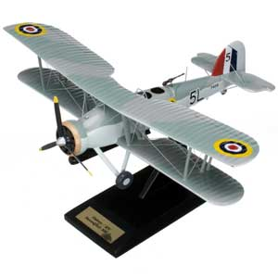
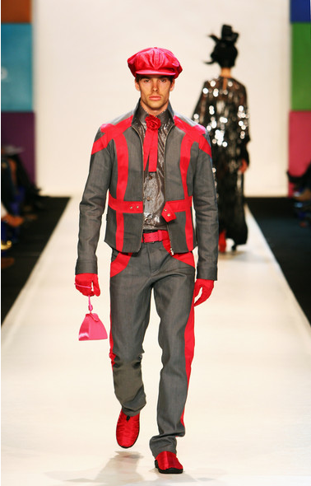
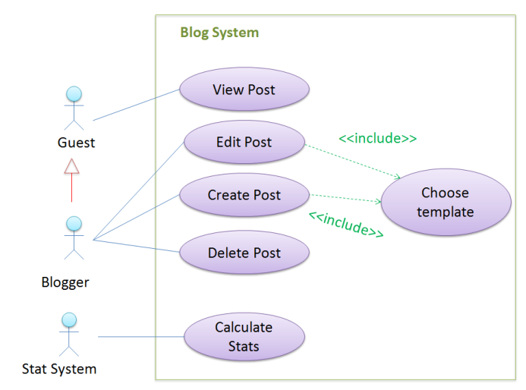
What word is common to all three?

Slide 2
models
What word is common to all three?
[… are representations of something else]

Slide 3

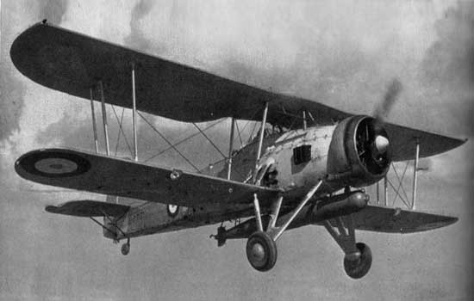
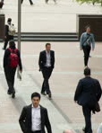
models
… are not the real thing!

Slide 4
models
… are simpler than the real thing!

Slide 5
models

Slide 6
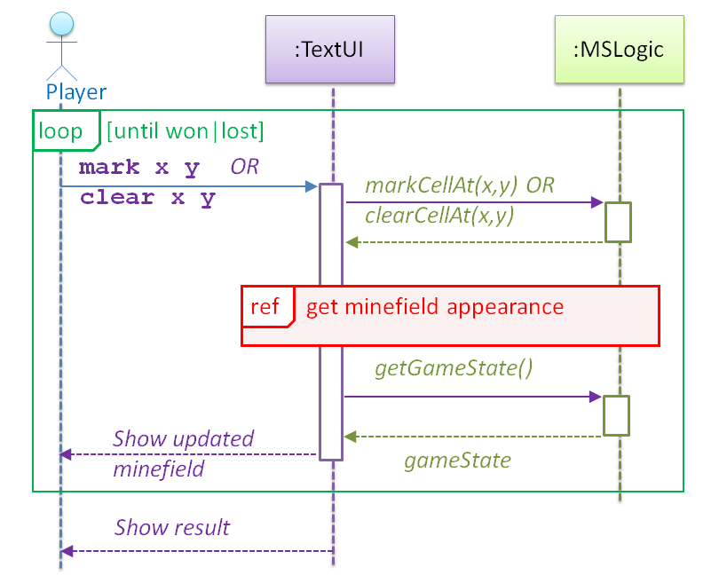
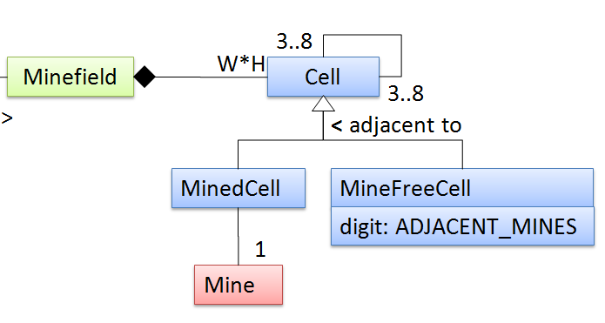
models
… capture different aspects

Slide 7
models
… combat complexity

Slide 8
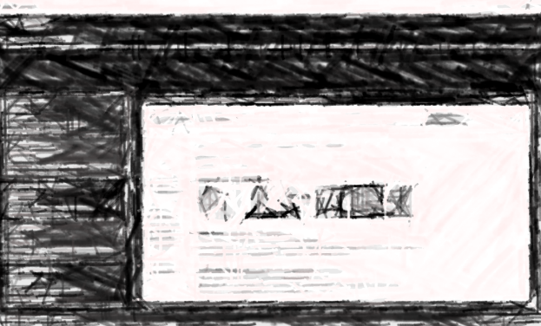
models
bigger roles in
… are indispensable for bigger projects

Slide 9
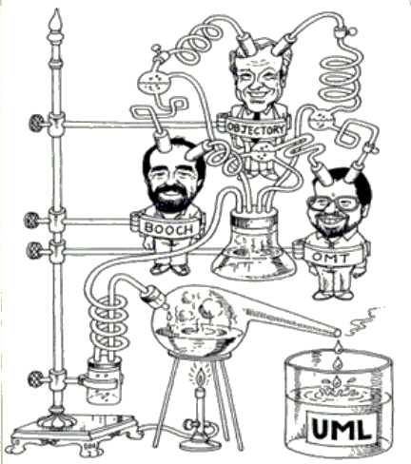
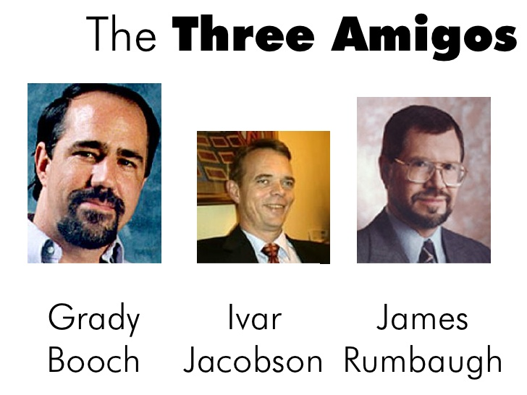
UML (Unified Modeling Language)
Grady Booch
Ivar Jacobson
James Rumbaugh
aka The Three Amigos

Slide 10
models
for what?
i. for analysis
ii. for communication
iii. as a blueprint

Slide 11

models
for what?
i. for analysis
ii. for communication
Nope, we don’t use UML diagrams
It’s all we got
iii. as a blueprint

Slide 12
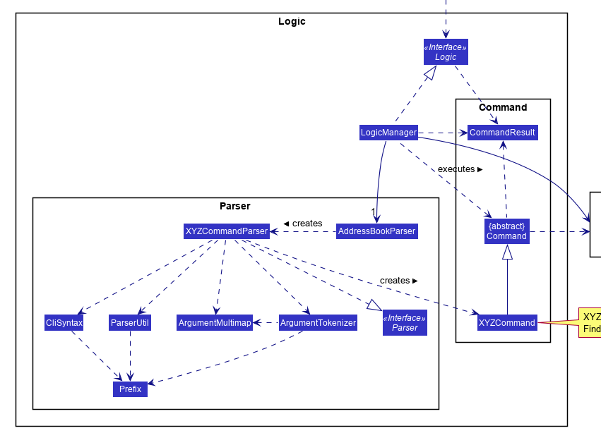
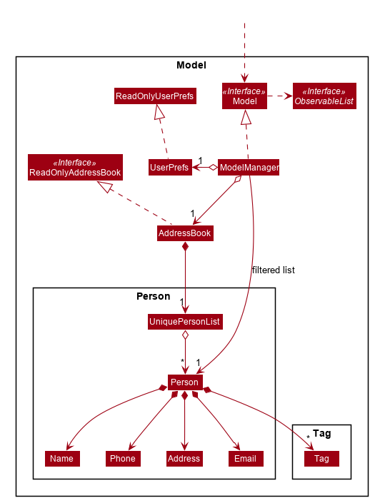
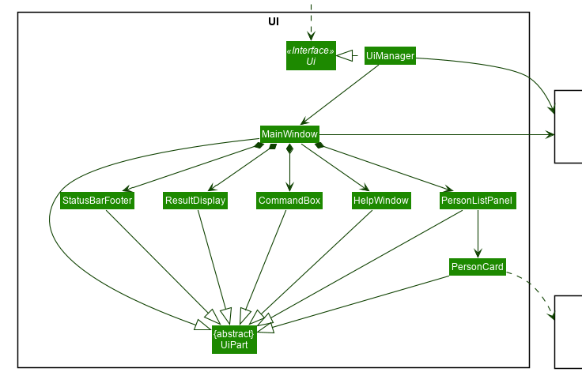
UML Modelling
Modeling structure
Modeling behavior
Class structure: class diagrams
Object structure: object diagrams
For the time being, interpreting only!
Diagram → implement code ? Not yet
Code → draw diagram? Not yet

Slide 13
Class diagrams
Classes
Student
-DOB -name
+getAge() +getName()
Admin
-students
+calculateAvgAge()
Visibility
ClassName
properties
methods
Student
-totalStudents
+getTotal()
Object diagram
:Student
DOB=1/1/1985 name=“John”
john:Admin
Objects
susan:Admin
objectIdentifier:ClassName
property=value property=value

Slide 14
Student
-DOB -name
:Student
DOB=1/1/1985 name=“John”
Choose the correct option
(a)
(b)
Student
DOB name
Student
DOB=1/1/1985 name=“John”
s1:Student
(c)
(d)
(e)
(a) & (c) are classes; (b) & (e) are objects
(a) is a class; (d) is an object
(c) is a class; (b) & (e) are objects
(a) is a class; (b) & (e) are objects
(a), (c) & (d) are classes; (b) & (e) are objects

Slide 15
CityConnect
Welcome to CityConnect! Enter command: addroute Clementi BuonaVista 12 Route from Clementi to BuonaVista with distance 12km added Enter command: getdistance Clementi BuonaVista Distance from Clementi to BuonaVista is 12 Enter command: getdistance Clementi JurongWest No route exists from Clementi to JurongWest! Enter command: addroute Clementi JurongWest 24 Route from Clementi to JurongWest with distance 24km added Enter command: getdistance Clementi JurongWest Distance from Clementi to JurongWest is 24 Enter command: exit

Slide 16
Class diagrams
CCLogic
-routes:Route[]
+addRoute(…) +getDistance(…)
Route

Slide 17
Class diagrams
CCLogic
-routes:Route[]
+addRoute(…) +getDistance(…)
Route
Association

Slide 18
For 1 of Route Objects, how many CCLogic objects?
For 1 of CCLogic Objects, how many Route objects?
CCLogic
Route
1
*
Multiplicity
n : exactly n e.g., 1, 2, 3, etc.
* : any number
0..1 : 0 or 1
1..* : 1 or more
n..m : n to m e.g., 2..4

Slide 19
CCLogic
Route
1
*
Roles

Slide 20
CCLogic
Route
1
managed by
*
keeps track of
Labels
Roles
Direction to read

Slide 21
CCLogic
+addRoute(…) +getDistance(…)
Route
1
managed by
*
0..1
0..1
keeps track of
longest
routes
r1:Route
:CCLogic
r1:Route
routes

Slide 22
CCLogic
Route
Navigability

Slide 23
CCLogic
+addRoute(…) +getDistance(…)
Route
1
managed by
*
0..1
keeps track of
0..1
1..*
City
Are routes directional here?
end points
2

Slide 24
CCLogic
Route
1
*
0..1
0..1
1..*
City
2

Slide 25
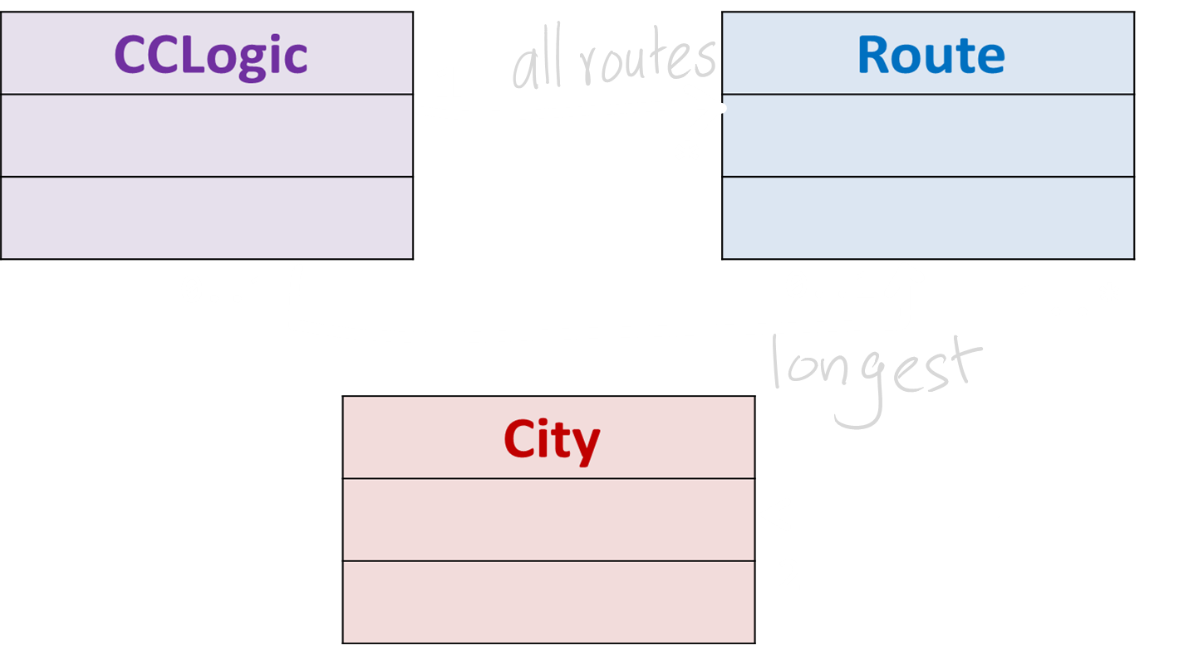
:CCLogic
r2:Route
r1:Route
longest
distance=7
distance=5
c3:City
c2:City
c1:City

Slide 26
Inheritance
wants to date
*
Person
*
A triangle, not an arrowhead
Man
Woman

Slide 27
Person
Student
Book
borrows
Chapter

Slide 28
Person
Student
Book
borrows
Composition
Chapter

Slide 29
Person
Shelf
Student
Book
borrows
Composition
Chapter

Slide 30
Person
Shelf
Student
Book
borrows
Composition
Chapter
Aggregation

Slide 31
Shelf
Book
Composition
Chapter
Aggregation

Slide 32
Shelf
Book
Composition
Chapter
Aggregation

Slide 33
Shelf
Book
Composition
Chapter
Aggregation

Slide 34
Shelf
Dependency
Student
Book
borrows
Difference?
This class is used to generate chapter previews
PreviewGenerator
Chapter

Slide 35
How to implement it?
Association classes
Student
Book
borrows
Represents the association
Loan
startDate
returnDate
:Loan
b2:Book
s1:Student
:Loan
b1:Book

Slide 36
Abstract classes
/methods
UGStudent
register()
*
{abstract}
Student
Admin
NGStudent
register()
register(){abstract}
{abstract}
PGStudent

Slide 37
Notes
Some info here
UGStudent
register()
*
{abstract}
Student
Admin
NGStudent
register()
register(){abstract}
{abstract}
PGStudent
Some more info here

Slide 38
Interfaces
Person
<<interface>>
Debtor
<<interface>>
Graded
<<interface>>
Client
<<interface>>
Payee
Student

Slide 39
Error handling

Slide 40
Prevent
Recover from
Investigate
MISUNDERSTANDINGS
MISHAPS
MYSTERIES
GO!
GO!
GO!

Slide 41
…
int size = Config.getSize();
if( 0 < size < 5)
setSizeAsSmall();
else
setSizeAsBig();
…
…
if(sizeFound())
return readSize();
else
return 0;
…
// size > 0

Slide 42
…
int size = Config.getSize();
if( 0 < size < 5)
setSizeAsSmall();
else
setSizeAsBig();
…
…
if(sizeFound())
return readSize();
else
return 0;
…
assert (size > 0)

Slide 43
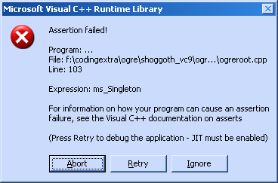
Assertions
In your project:
Use assertions where applicable
…
int size = Config.getSize();
if( 0 < size < 5)
setSizeAsSmall();
else
setSizeAsBig();
…
…
if(sizeFound())
return readSize();
else
return 0;
…
assert (size > 0)
Make your assumptions explicit. Get the runtime to confirm them.

Slide 45
My computer crashes when I flush the toilet!

Slide 46
…
int size = Config.getSize();
// size > 0
if( 0 < size < 5)
log(LEVEL_INFO, “Setting size to small”);
setSizeAsSmall();
else if( size > 5)
setSizeAsBig();
else
log(LEVEL_WARN, “size not recognized”);
…

Slide 47
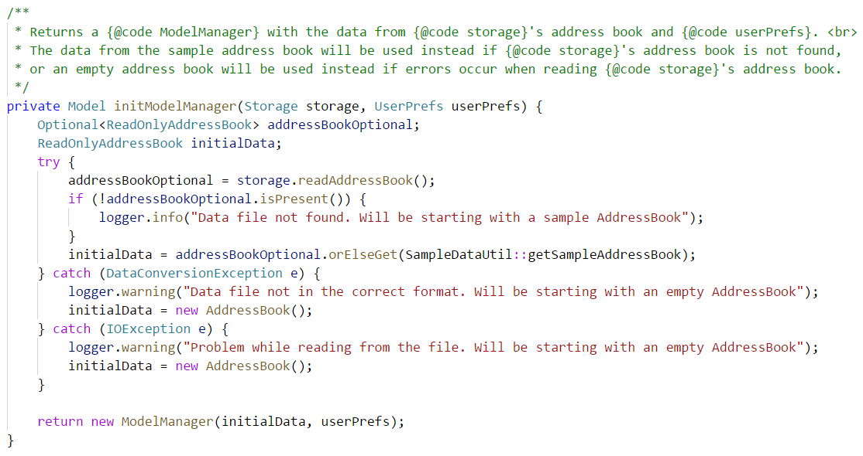
Record information during execution;
use later (mainly) for troubleshooting

Slide 48
java.util.logging.*
Log levels
SEVERE
WARNING
INFO
CONFIG
FINE
FINER
FINEST
Logger logger = Logger.getLogger(“main”);
In your project:
Must use logging
logger.log(Level.INFO, “Start processing");
logger.setLevel(Level.INFO);
logger.info(“Start processing”)
X
logger.fine(“Initialize logger object”)

